Slide 1

KIET Group Of Institutions
Summify
Simplified Document Summarization using AI
Submitted By: Mentor:
Sanat Mishra(2100291520048) Mr. Abhishek Shukla
Vibhaw Kumar(2100291520061)
Rishabh Kanaujiya(2100291520045)

Slide 2

Summify
This project aims to streamline information processing by summarizing and highlighting information from PDFs, enabling users to access essential content efficiently. It seeks to save time and enhance understanding of complex information.

Slide 3
Project Abstract
Overview
Key Objectives
Approach
It is an AI-powered tool that uses large language models to extract and summarize information from PDFs. It enables users to quickly grasp essential content, making information more accessible & easy to understand.
Summify allows users to chat with PDFs, extracting content, retrieving relevant info using ChromaDB, Interactive Q&A feature to streamline information retrieval, generating accurate answers via Google Gemini in a simple Streamlit interface.
Summify uses LangChain to load and split PDFs, generates embeddings with Google AI, stores vector embeddings in ChromaDB, retrieves relevant chunks, and queries Gemini to generate accurate, context-based answers.

Slide 4

Technology Stack
Programming Language: Python
LangChain (PyPDFDirectoryLoader, RecursiveCharacterTextSplitter)
LLM used: Google Gemini
StreamLit (for UI)
ChromaDB (Vector Database)
Embeddings: Google Generative AI

Slide 5

Project Goals and Objectives
Interactive
1
Implement interactive question-answering for user engagement enabling user interaction.
2
Information Retrieval
Develop efficient document summarizer to condense text, manage information overload.
Decision Making
3
Leverage AI-driven tools to automate the extraction and analysis of relevant data, enabling users to make data-driven decisions efficiently.

Slide 6

Workflow
PDF upload
User uploads the PDF
Extraction
Text is extracted and processed.
Embeddings Generations
Embeddings are generated for efficient search.
Summarisation modules summarises the document
Summarisation

Slide 7





Methodology and Approach
Data Collection and Preprocessing
Collect and preprocess diverse documents (PDFs, reports, data files) by cleaning, extracting text, and converting them into AI-compatible formats for accurate analysis.
Technology Integration
Utilize large language models (LLMs) and generative AI to develop algorithms capable of understanding, summarizing, and analyzing the content
Interaction
Create an intuitive, user-friendly interface for uploading documents, providing personalized summaries, Q&A, and seamless navigation to enhance the user experience.
Testing and Optimisation
Perform thorough testing, gather user feedback, refine AI models, and optimize the tool for accuracy, scalability, and real-time performance.

Slide 8
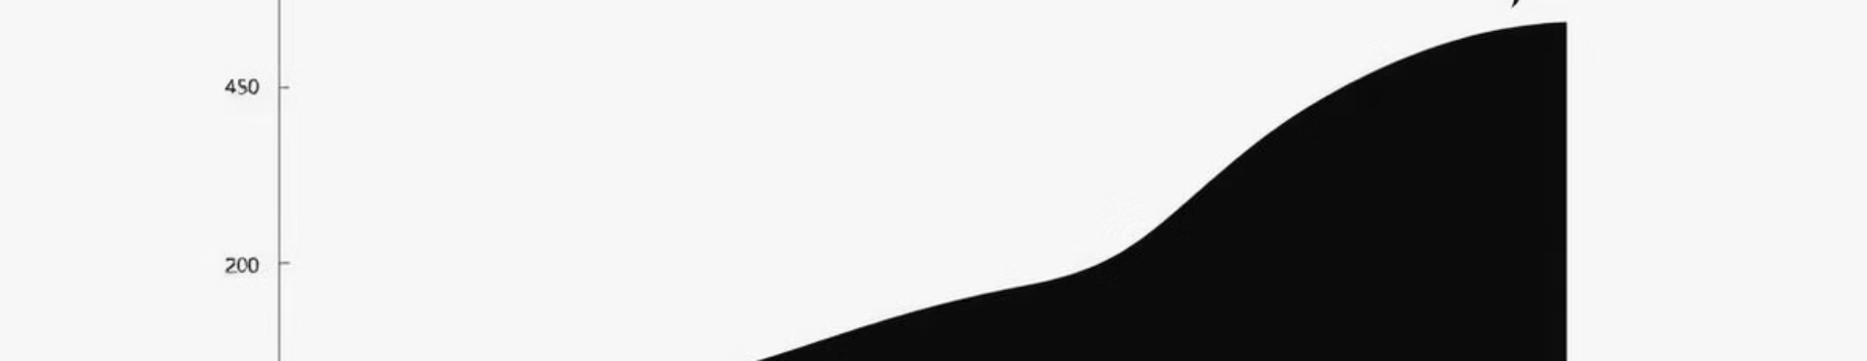



Expected Outcomes and Impact
Improved Efficiency
Enhanced Decision-Making
Increased Accessibility
Summify will save time by providing concise summaries and quick access to key information.
Summify will enable informed decisions by providing tailored, data-driven insights from complex content.
Summify will make complex documents accessible, helping users of all expertise quickly grasp key details and take action.

Slide 9
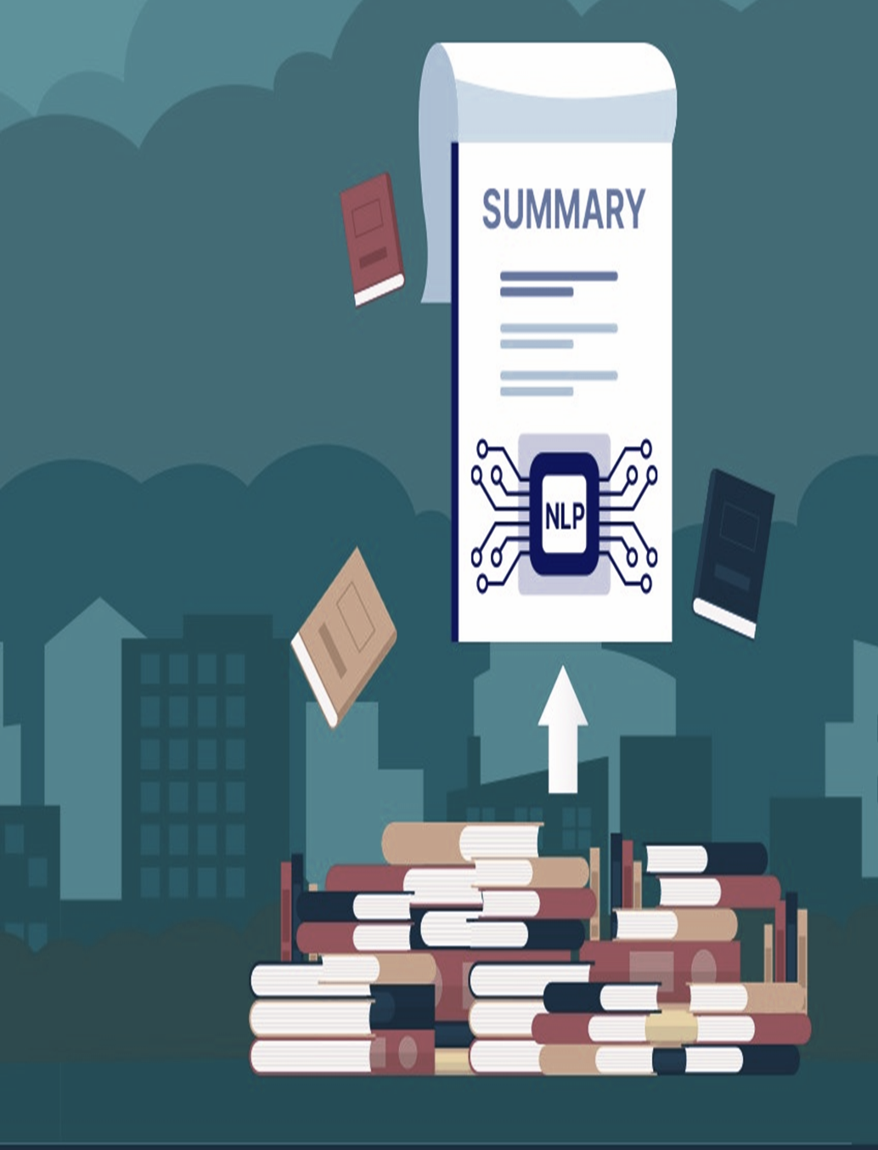
Key Project Deliverables
Automated document
Summarizer
Tool for extracting and summarizing insights.
User interface for personalized information retrieval and engagement with summaries.
Interactive Q&A Feature
Comprehensive User Dashboard
Centralized interface for managing documents, summaries, and interactive insights.

Slide 10
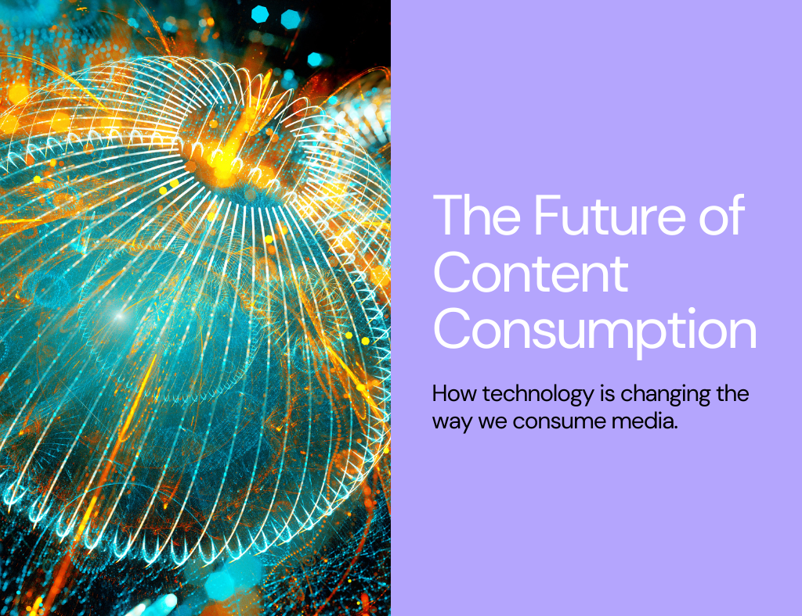
Next Steps and Conclusion
1
Multi Document
2
Multi-language support
Developing system to summarize multiple documents.
Developing the system to summarize different languages document than only English.
Voice-Based
3
Voice-Based interactions to be
Integrated in the system.

Slide 11
Bibliography
S. No. | Publisher | Year | Methodology/ Technology | Scope
[1] | IEEE | 2023 | Automatic Text Summarization | Exploring the Landscape of Automatic Text Summarization
[2] | IJISAE | 2024 | LLM, Langchain | Abstractive Long Text Summarization using
[3] | Research Gate | 2023 | LLM, Langchain | Creating LLM Applications Utilizing LangChain
[4] | ARXIV | 2023 | LLM | Text Summarization Using LLM
[5] | ARXIV | 2023 | Langchain | Comparative Study and Framework for Automated Summariser
[6] | IEEE | 2021 | Cosine Similarity | Comparative Analysis of Different Text Summarization Techniques using Enhanced Tokenization
[7] | IEEE | 2021 | TextRank | Comparative Study of Extractive Text Summarization Techniques
[8] | IEEE | 2020 | Reinforcement Learning | A Survey of Automatic Text Summarization Technology
[9] | IEEE | 2014 | Graph and Similarity Based | A Context Based Text Summarization System
[10] | IEEE | 2012 | Text Mining | Using a Text Mining Tool to Support Text Summarization

Slide 12

Thank you

